Slide 1
Categorizing Kaggle Competitions by Degree of Difficulty
Group 5
SIDDHARTH PARAAG NILAKHE
MEHUL SUDHAKAR INGALE
PREETI REDDY KOPPOLU
BHANODAY SAKAMURI
Under the guidance of
Prof. Rong Liu

Slide 2
Problem Description
Kaggle competitions are made to offer challenges to participants at all levels of Data Science careers.
We developed a model that determines a competition's difficulty level based on several factors, including prize, prize, teams, tiers, and points.
We also predicted the most important feature that will determine the competition's success based on the number of entries.

Slide 3
Research Questions
Research question 1: Do the Kaggle competitions have varying levels of difficulty? How many and what elements go into these hardness levels? How many different levels of difficulty may the contests be divided into? Examine whether this classification is assisting brand-new Kaggle users in acclimating to the system.
Research question 2: Is the popularity of the organization that posts a competition the only factor in the competition's success? Or is it the product of several factors?Determine all such characteristics that make a competition successful on Kaggle.

Slide 4
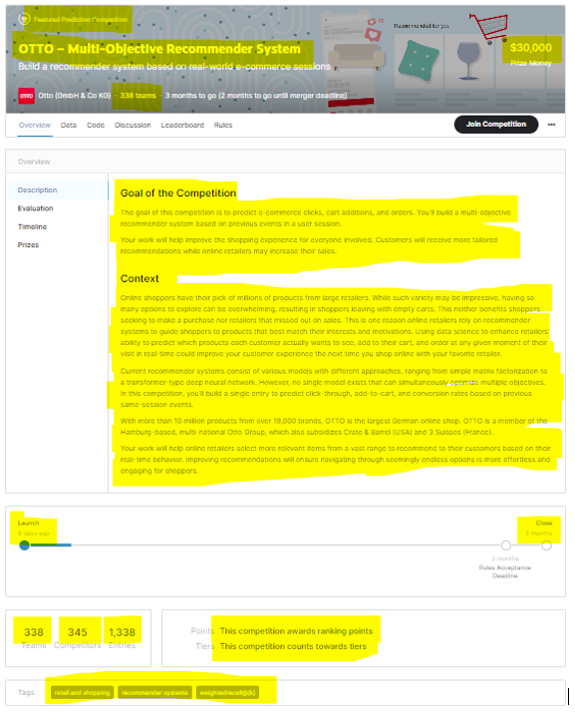
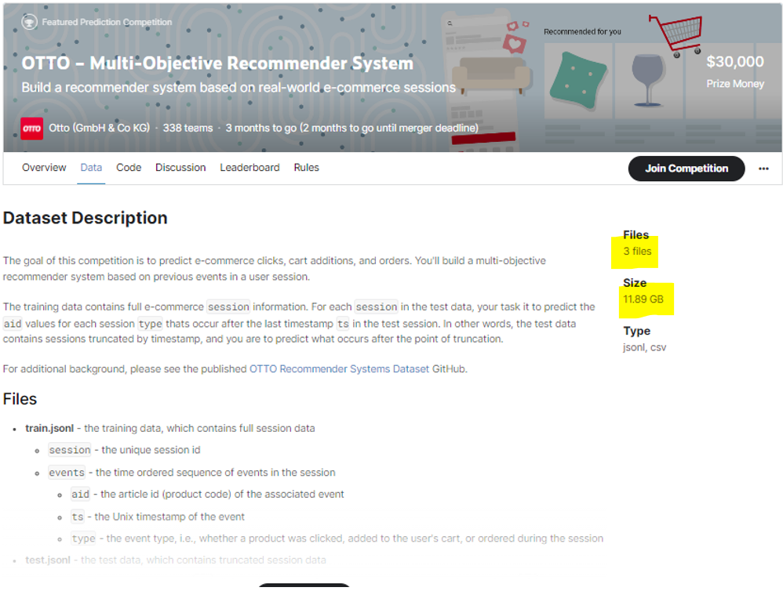
Methodology
Data Collection
The dataset for this project has been scraped from https://www.kaggle.com competitions page. We have used selenium chrome web driver to navigate and log into to Kaggle’s website. Then the algorithm opens each competition page and scrapes multiple fields .

Slide 5
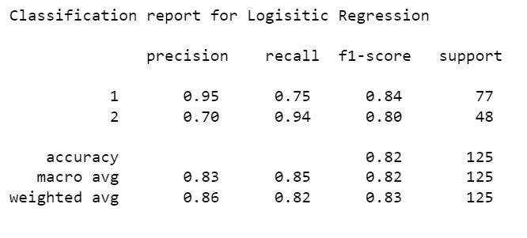
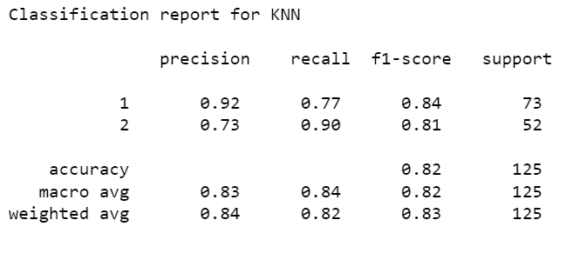
Methodology
Algorithms
Logistic Regression :
After using the GridSearchCV() for the logistic regression model we got the accuracy of 82.4%.
K Nearest Neighbors Classifier:
We trained the model with K = 25 and got the accuracy of 82.4%.

Slide 6
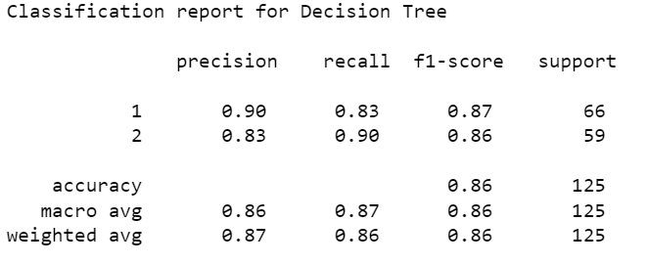
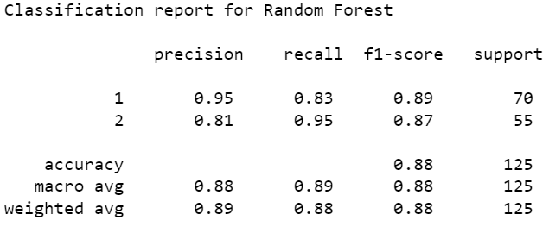
Methodology
Algorithms
Decision Tree Classifier :
We obtained an accuracy of 84.8% after training the model with a decision tree classifier. After that, we performed "post pruning" and "pre pruning" achieving accuracy rates of 86.4% and 83.2%, respectively. The model gives a better result after performing the post-pruning method with 86.4%.
Random Forest Classifier:
After using the GridSearchCV() for the Random Forest model we got the accuracy of 88%.

Slide 7
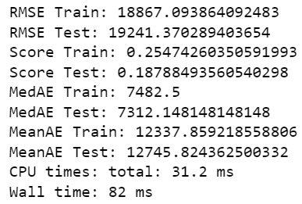
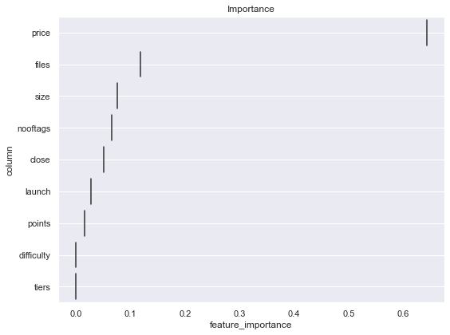
Popularity Feature:
We used the number of entries as the target feature that predicts the popularity of the successful Kaggle competition.
We enhanced the test score and obtained some of the best parameters by using the hyperparameter tuning method.
AdaBoost Regressor:

Slide 8
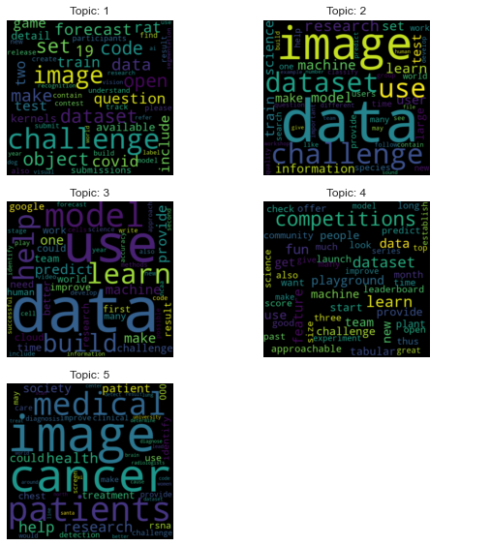
Topic Modelling:
Preprocessed description text by removing stopwords.
We used the Latent Dirichlet Allocation method to find topics that the description belongs to, based on the words it contains. It is assumed that descriptions with similar topics will use a similar group of words.

Slide 9
Conclusion:
According to the above mentioned findings, when categorizing the degree of difficulty, the DecisionTreeClassifier() and RandomForestClassifier() algorithms performed best.
After applying the post pruning procedure to the decision tree, we obtained the best accuracy of 86.4%. Using the grid search technique, we were able to achieve an accuracy of 88% for the random forest classifier.
Random forest classifiers is the most effective model for categorizing a competition's difficulty level.
In the case of popularity prediction, the majority of the algorithms predicted that the most important factor in determining the success of a Kaggle competition is the ‘price’ feature.
AdaBoostRegressor provided us with the highest test result among all the other algorithms we used after applying the random search approach.

Slide 10
Future Work:
The root mean squared error we obtained while predicting the popularity of a competition is high.
Analyze the competitions page on https://www.kaggle.com.
Scrape extra features that can explain the popularity of the competition.
Expand our dataset to contain more features that can best describe the target variable, i.e. number of entries for a competition.

Slide 11
References:
https://www.kaggle.com/competitions
Thakur, Abhishek, and Artus Krohn-Grimberghe."Autocompete: A framework for machine learning competition." arXiv preprint arXiv:1507.02188 (2015)
Lam, Hoang Thanh, Johann-Michael Thiebaut, Mathieu Sinn, Bei Chen, Tiep Mai, and Oznur Alkan. "One button machine for automating feature engineering in relational databases."arXiv preprint arXiv:1706.00327 (2017).
Solomatine, Dimitri P., and Durga L. Shrestha. "AdaBoost. RT: a boosting algorithm for regression problems." In 2004 IEEE International Joint Conference on Neural Networks (IEEE Cat. No. 04CH37541), vol. 2, pp. 1163-1168. IEEE, 2004.
Tong, Zhou, and Haiyi Zhang. "A text mining research based on LDA topic modelling." In International conference on computer science, engineering and information technology, pp. 201-210. 2016.

Slide 12
THANK YOU
Stevens Institute of Technology
1 Castle Point Terrace, Hoboken, NJ 07030

